Slide 1
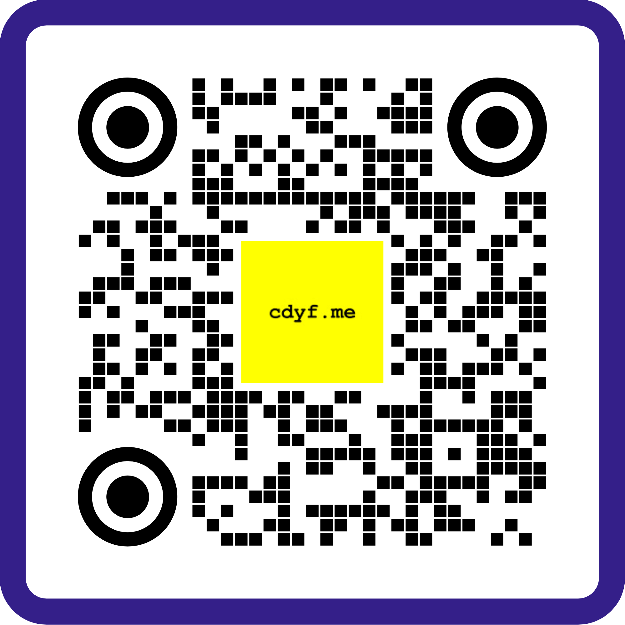
DEBUG YOUR CV HERE : WEDS 10-12
Self debug using checklist cdyf.me/debugging#quick
Submit CV with this code ➡️ or form ⬇️ bit.ly/debug-my-cv
Join the live session here* or wait for asynchronous feedback via teams.microsoft.com
“here” = Lower first floor of the Kilburn Building, outside Collab 1

